Slide 1
Recent Work: SE-HCI Integration
Software Engineering（SE）- Human-Computer Interaction（HCI): Integration
  Usage model or operational profile in SE/SRE, task model in HCI, and event model from execution logs): Integration for reliability/usability improvement
  R. Geng and J. Tian, Improving Web Navigation Usability by Comparing Actual and Anticipated Usage, IEEE Trans. on Human Machine Systems, Vol.45, No.1, pp.84-94. Feb. 2015.
  G. Karami and J. Tian, Maintaining accurate web usage models using updates from activity diagrams, Information and Software Technology, Vol.96, pp.68-77, April, 2018.
  + 2 other papers (Karami & Tian)
1

Slide 2
Accurate Usage Models: Open Problem
The accuracy of the initial Markov OP deteriorate over maintenance and evolution
  negatively affect on test coverage, test efficiency, reliability, and usability of the web application.
Updated web application is not under deployment
  do not have access to the actual measurements.
Survey or expert knowledge
  provide less accurate information for Markov OP construction.

Slide 3
Maintain Accurate OP
Take advantage of existing or possible information sources
  The initial Markov OP: usage patterns are not expected to change drastically.
  Activity diagrams (from OOD etc.) or task model (from HCI/UCD) share common characteristics with Markov OP
By comparing activity diagrams or task models with the initial Markov OP
  how maintenance and evolution affect the usage of the updated web application.
IST paper (Karami and Tian, 2017/2018) and related papers on improved testing coverage, efficiency and reliability

Slide 4
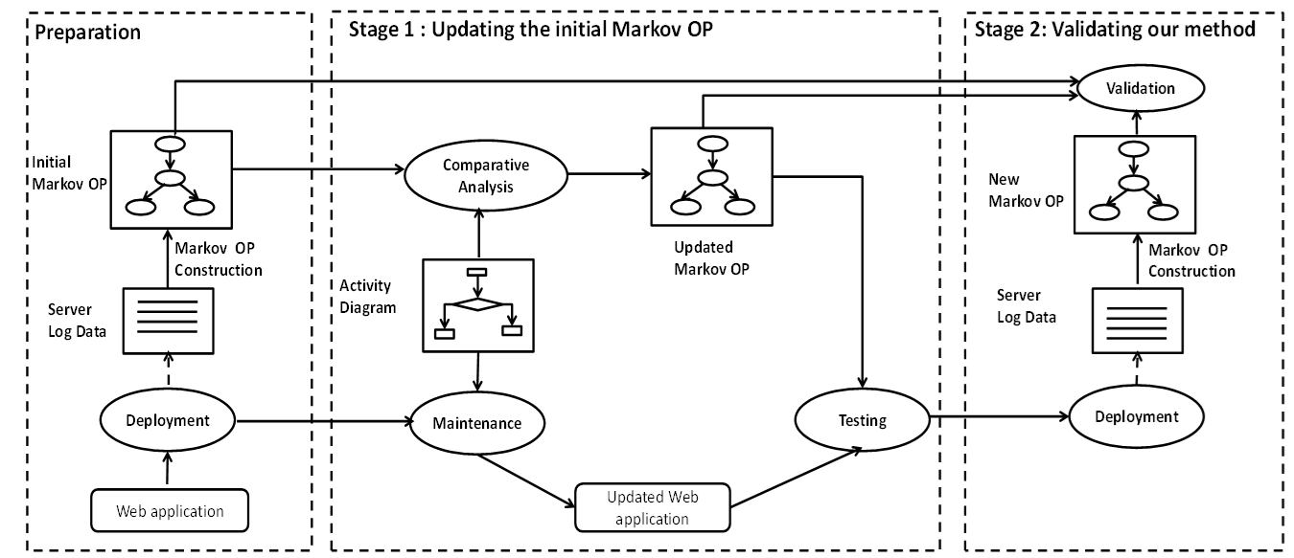
New Method to Maintain Accurate OP

Slide 5
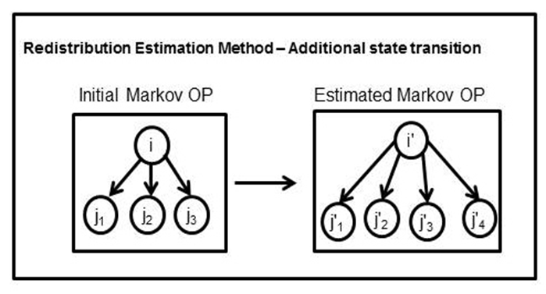
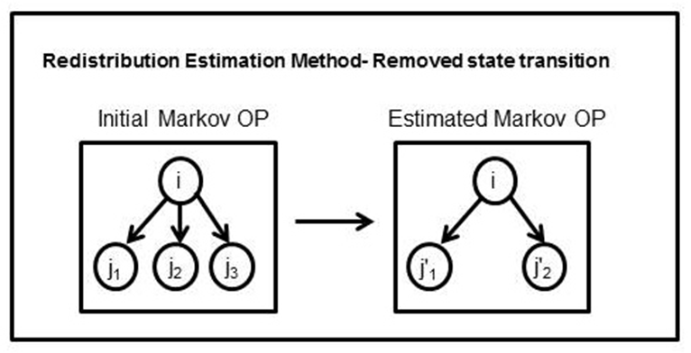
Structure Update
Update the initial Markov OP by adding corresponding states and state transitions added during maintenance
Update the initial Markov OP by removing corresponding states and state transitions removed during maintenance

Slide 6
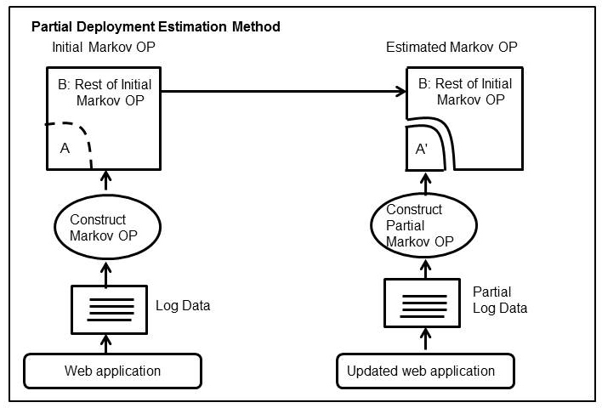
Method 1/3: Transition Probability Update
  Substitute transition probabilities estimated from the new data for those in the corresponding subset of the initial Markov OP

Slide 7
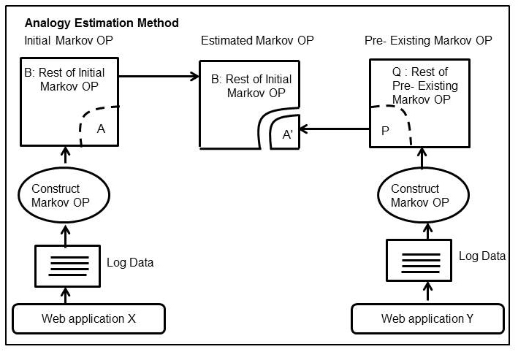
Method 2/3: Transition Probability Update
  Substitute a subset of the updated Markov OP with a similar subset in the initial Markov OP or a pre-existing Markov OP

Slide 8
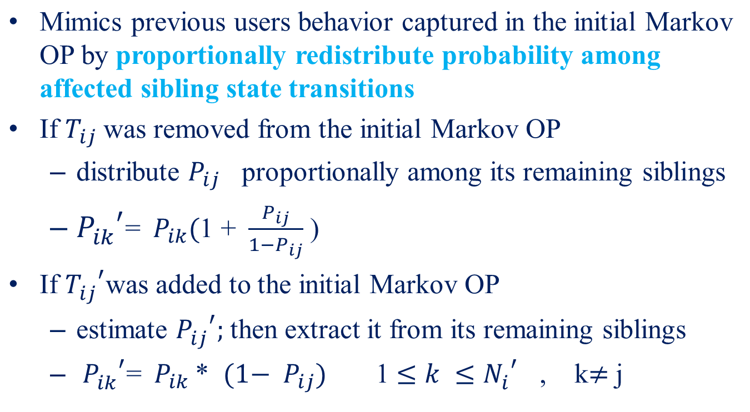
Method 3/3: Transition Probability Update

Slide 9
Quantifying Markov OP Accuracy
  Comparing a given Markov OP a reference Markov OP
      Missing states or transitions
      Extra states or transitions
      Incorrect states or transitions
a) Reference Markov OP
b) Markov OP with missing states
S_{c}
S_{m}
S_{c}
c) Markov OP with Extra states
d) Markov OP with incorrect states
S_{c}
S_{c}
S_{m}
S_{e}
S_{e}

Slide 10
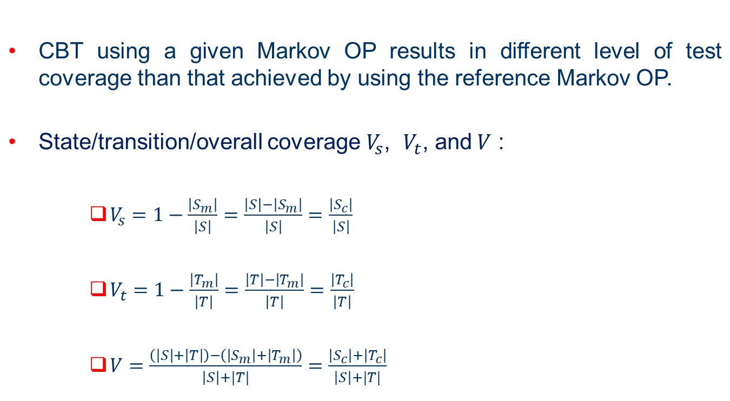
Impact: OP Accuracy on Test Coverage

Slide 11
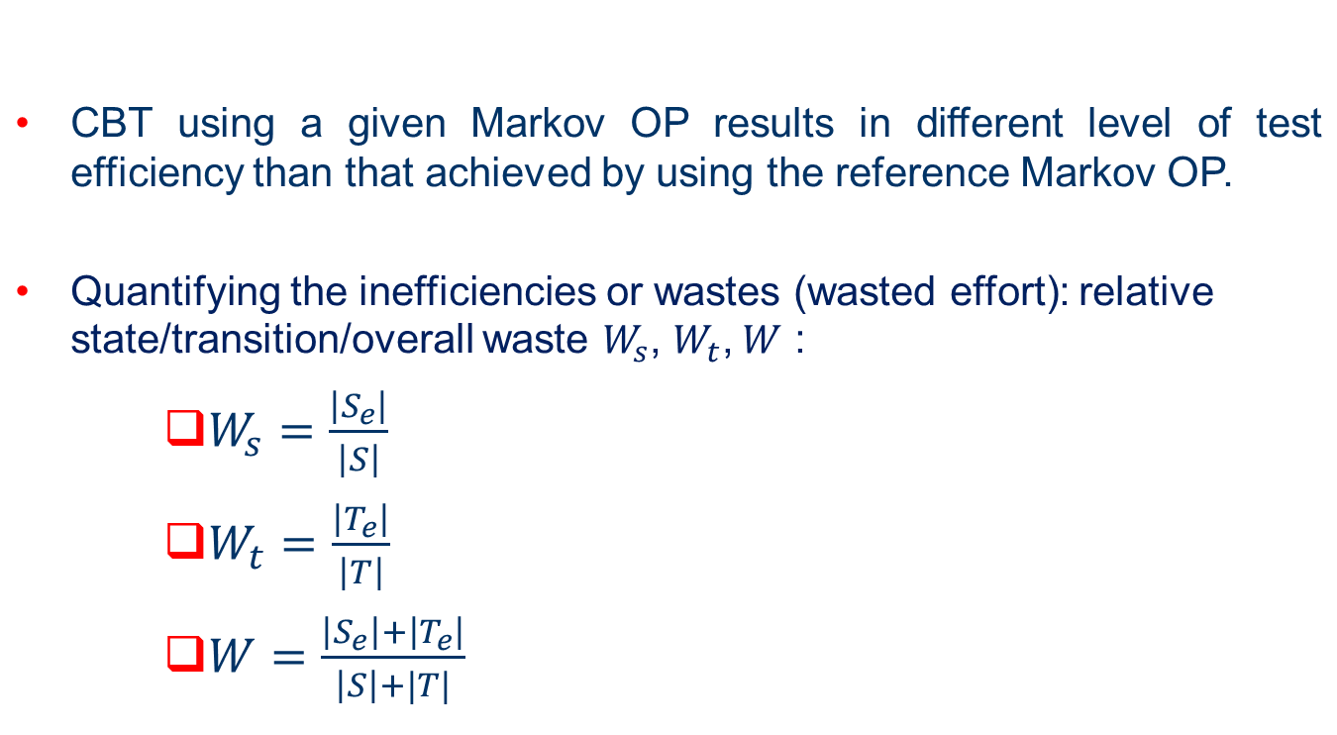
Impact: OP Accuracy on Test Efficiency

Slide 12
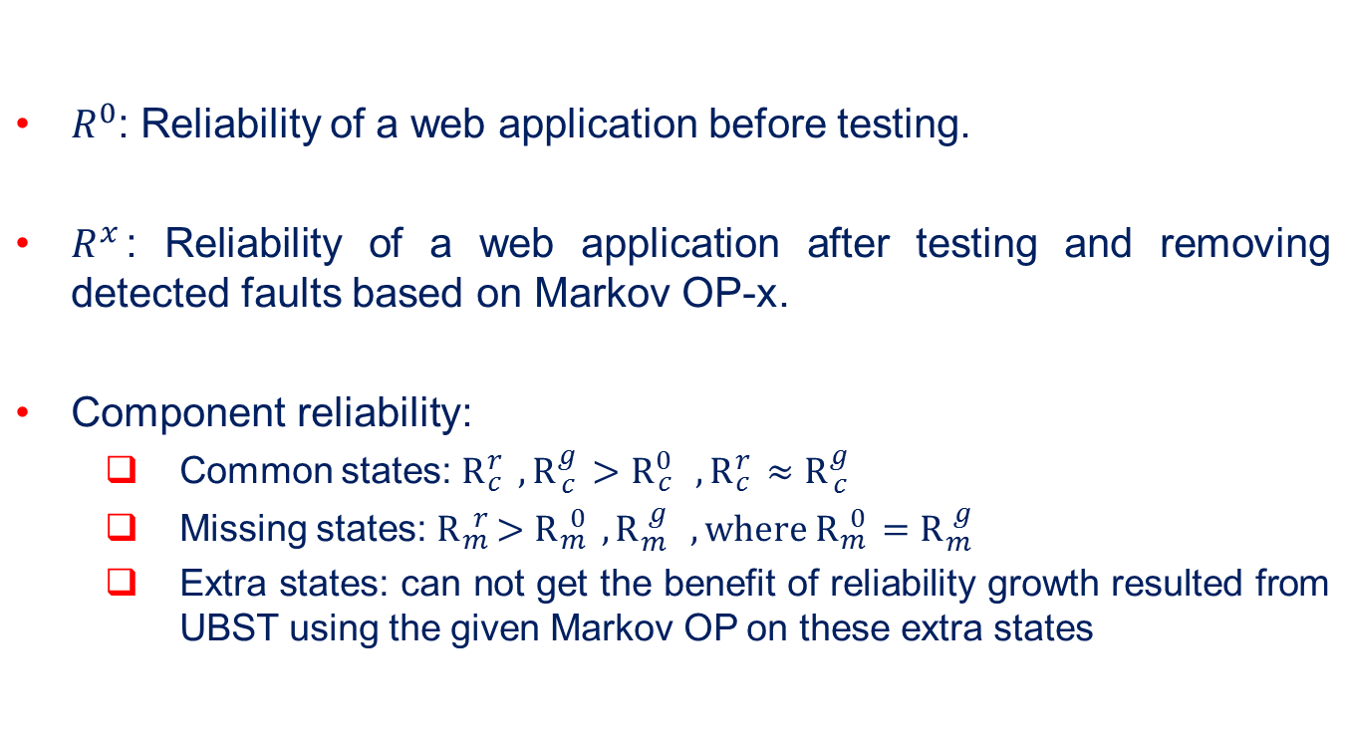
Impact: OP Accuracy on Reliability

Slide 13
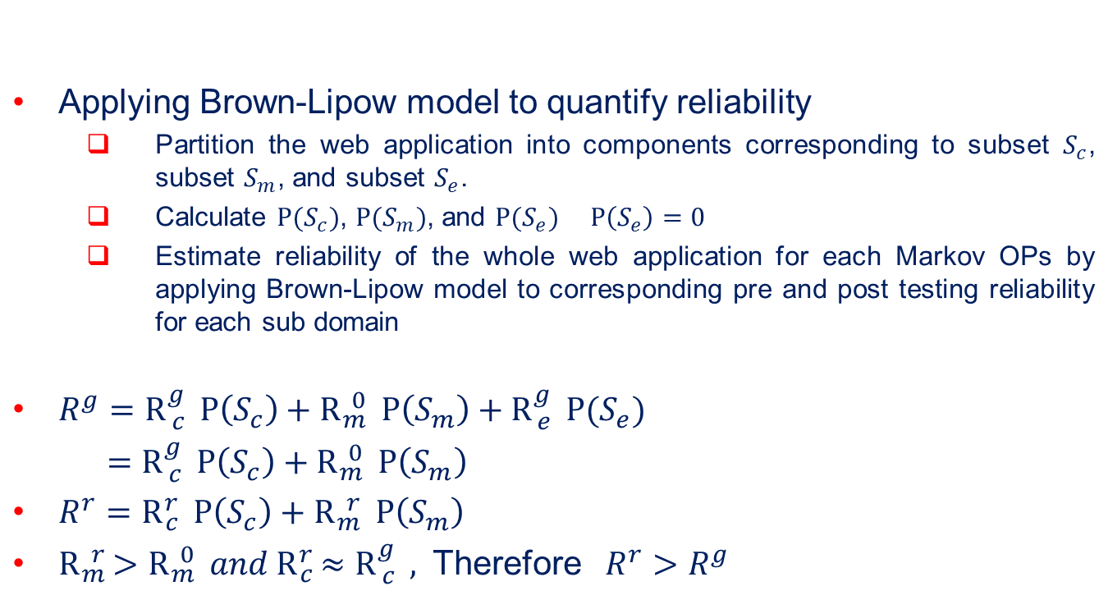
Impact: OP Accuracy on Reliability

Slide 14
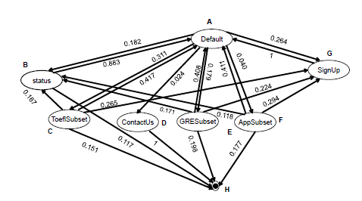
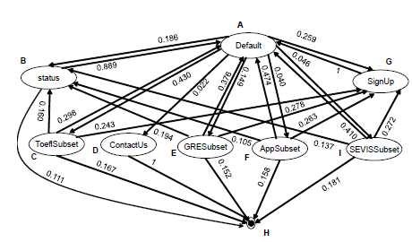
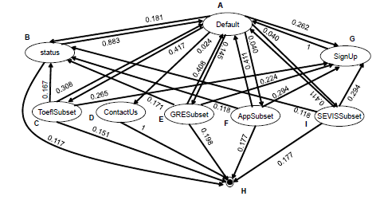
Case Study – Markov OPs
Initial Markov OP as Whole
Updated Markov OP as Whole
Reference Markov OP as Whole

Slide 15
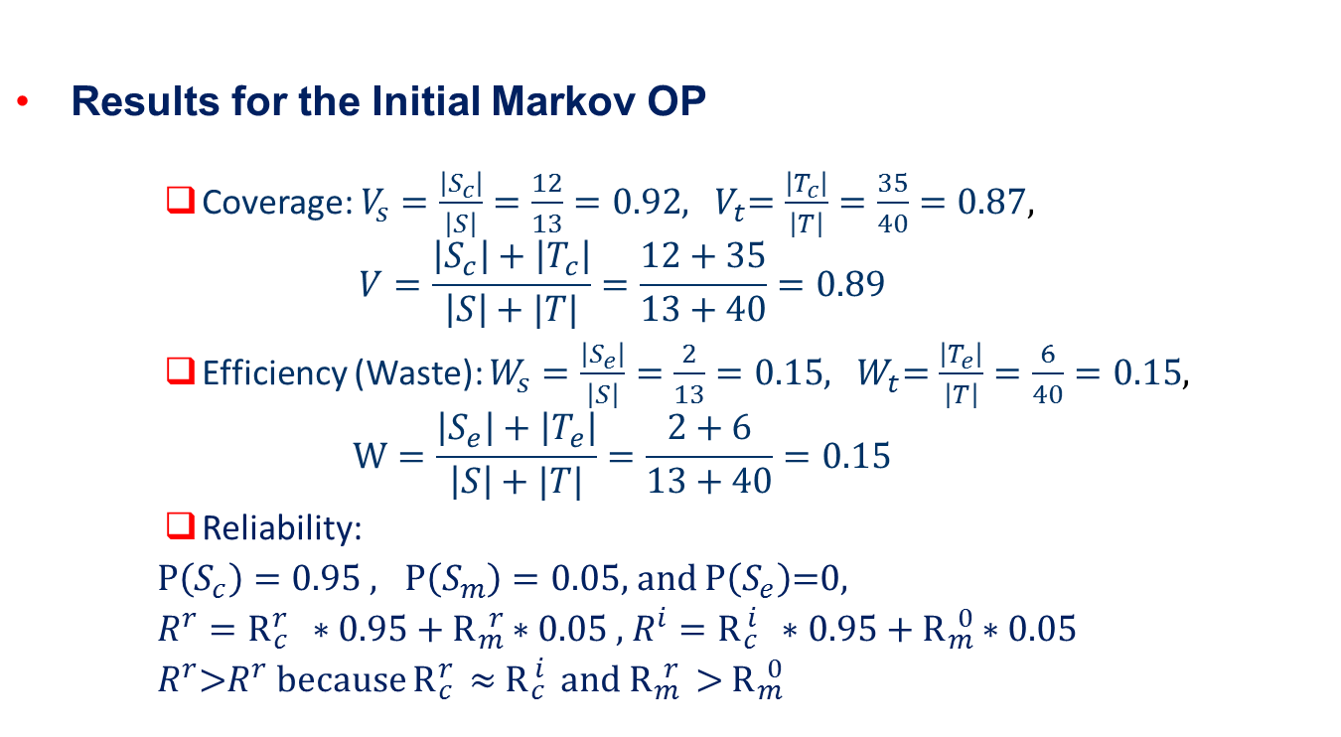
Case Study- Impact of OP Accuracy

Slide 16
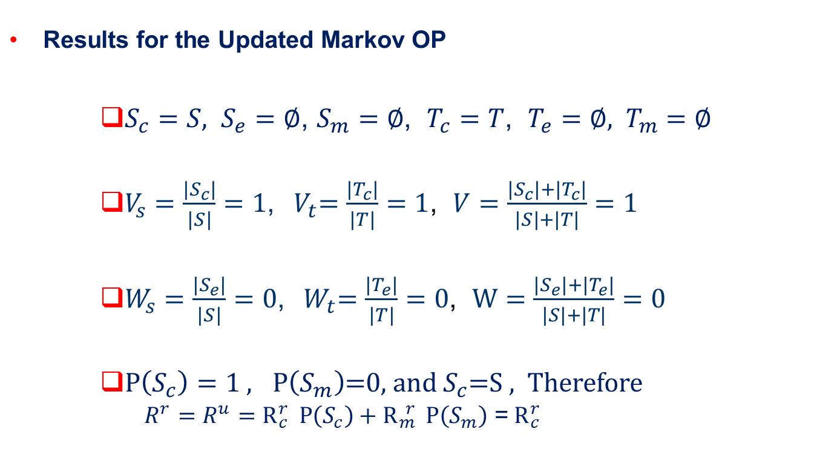
Case Study- Impact of OP Accuracy

Slide 17
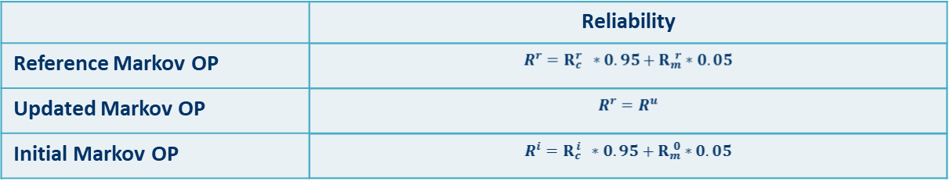
Case Study: Result Comparison
 | State Coverage | Transition Coverage | Overall Coverage
Reference Markov OP | 1 | 1 | 1
Updated Markov OP | 1 | 1 | 1
Initial Markov OP | 0.92 | 0.87 | 0.89
 | State Waste | Transition Waste | Overall Waste
Reference Markov OP | 0 | 0 | 0
Updated Markov OP | 0 | 0 | 0
Initial Markov OP | 0.15 | 0.15 | 0.15

